Slide 1
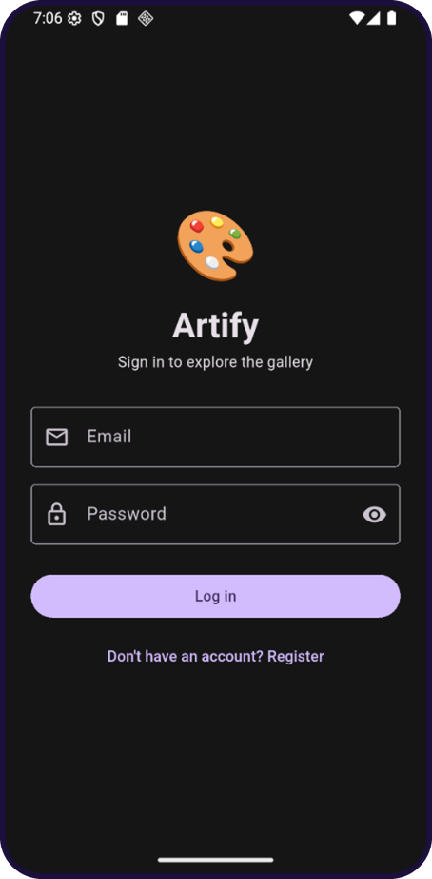
MOBILE DEVELOPMENT USING FLUTTER | FINAL PROJECT
Artify
A digital art gallery & shop built with Flutter and Supabase
Presented by
Sgdh Elnemr
Notes:
Introduce yourself and the project. Artify is a digital art gallery and shop built with Flutter, Provider and Supabase.

Slide 2
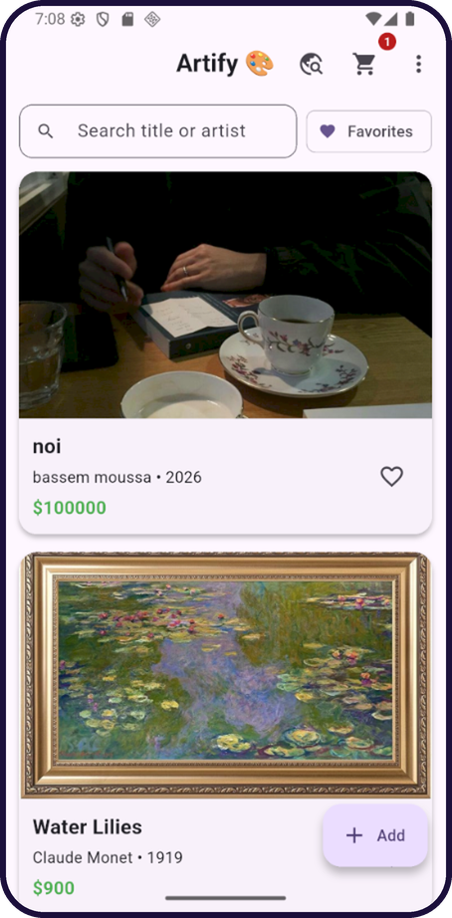



Project Overview
What it is
A digital art gallery & shop built with Flutter and Supabase
What users do
Sign in, browse paintings, like, comment, add to cart and check out
What else
Add, edit and delete paintings, and import artworks from a public art API
Artify | Mobile Development using Flutter
2
Notes:
Explain in one sentence what Artify is, then what users can do. Mention it is an individual project.

Slide 3






Application Features
Authentication
Gallery
Comments & Cart
Register, log in, log out. The session persists between launches.
Loading, error + retry and empty states. Search, favorites filter, pull-to-refresh.
Comments stored in Supabase. Cart with badge and total, saved locally.
Full CRUD
Discover
Polish
Add, edit and delete paintings. Swipe to delete with confirmation.
Search the Art Institute of Chicago API and import artworks.
Dark mode, form validation and friendly error handling.
Artify | Mobile Development using Flutter
3
Notes:
Walk through the six feature groups quickly; the demo will show them live.

Slide 4
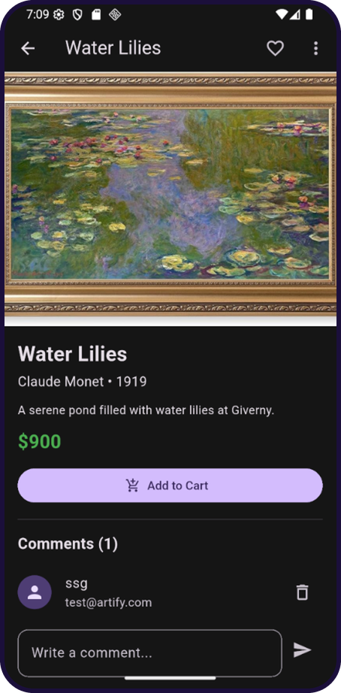
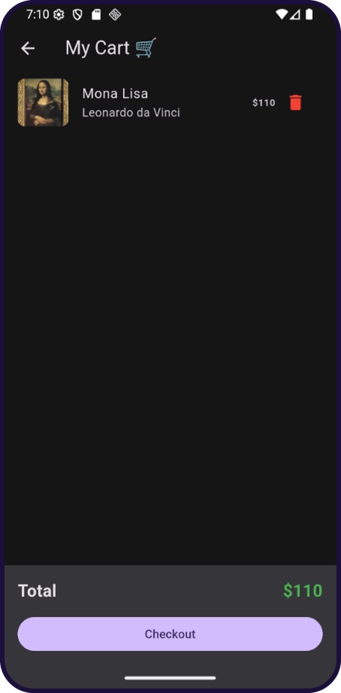
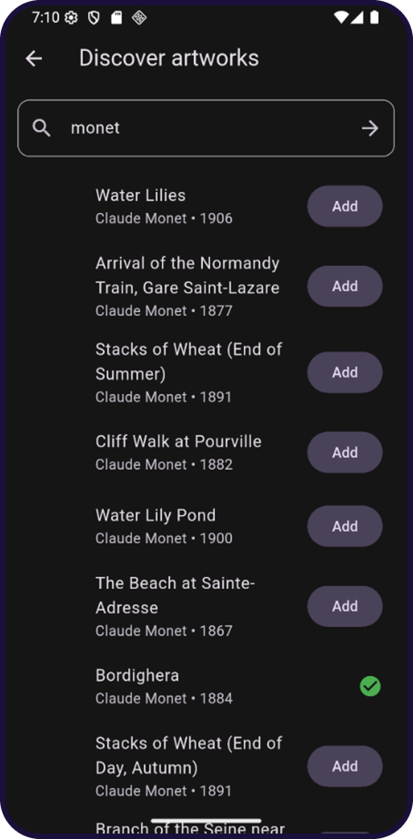
App Screens
Gallery
Details & comments
Cart
Discover (API)
Artify | Mobile Development using Flutter
4
Notes:
Quick visual tour: gallery, painting details with comments, the cart, and the Discover screen that uses the public API.

Slide 5
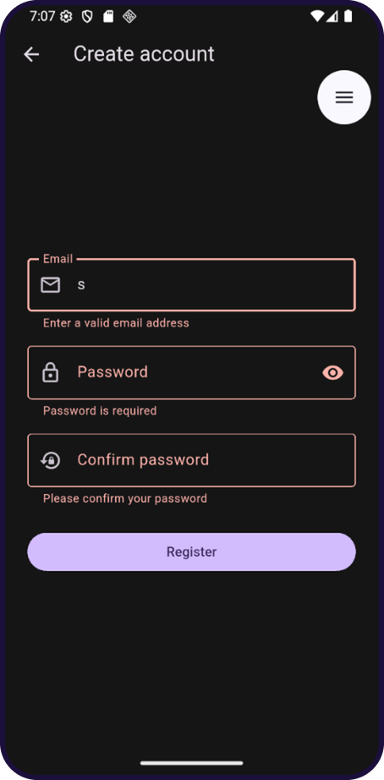
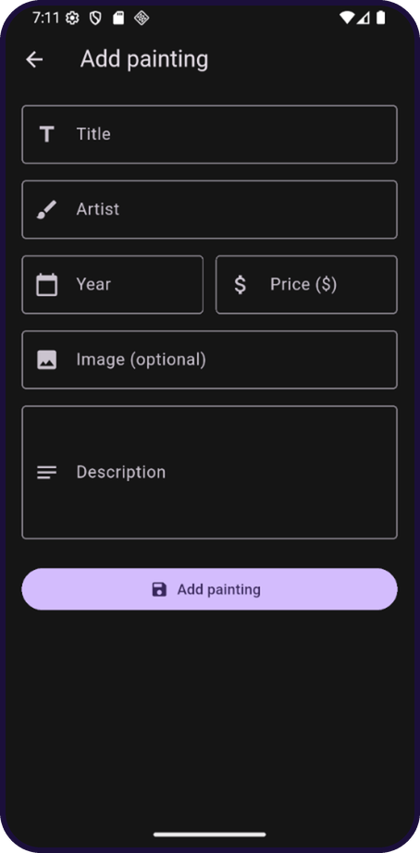
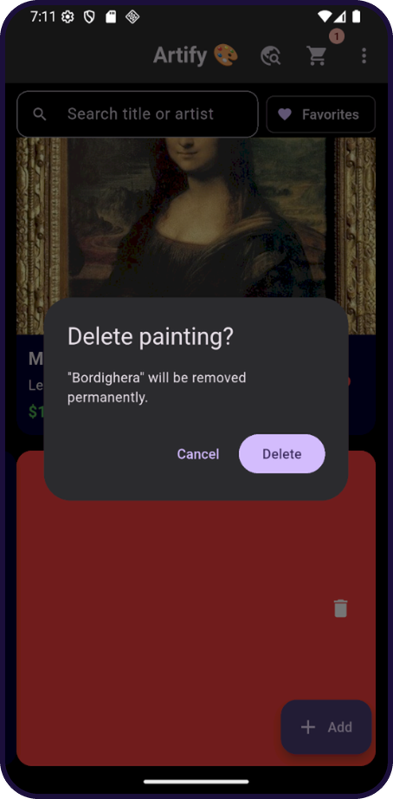
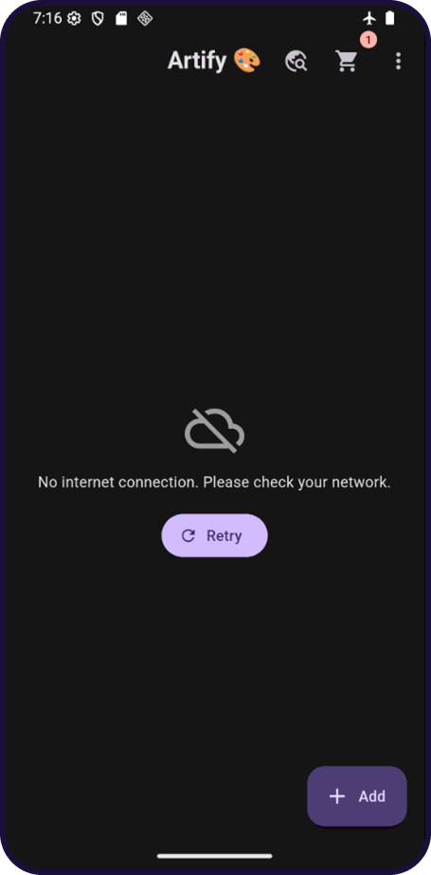
Validation, CRUD & Error Handling
Form validation
Add / edit painting
Delete confirmation
Offline error + Retry
Artify | Mobile Development using Flutter
5
Notes:
Validators show clear messages, the same form handles add and edit, delete asks for confirmation, and errors such as no internet show a friendly message with Retry.

Slide 6



System Architecture
Supabase
Auth + Postgres + RLS
UI
Providers
Services
SharedPreferences
Dark mode, likes, cart
Screens & widgets
Named routes
AuthGate
Auth, Painting, Cart, Theme
(ChangeNotifier)
supabase_service
art_api_service
local_storage
Art Institute API
REST (http)
Code layout: models | services | providers | screens | widgets | utils | config
Artify | Mobile Development using Flutter
6
Notes:
Explain the layers: the UI never talks to the backend directly. Screens read and update state through providers, providers call services, and services talk to Supabase, SharedPreferences and the public REST API. Separating them keeps the code organised and easy to change.

Slide 7
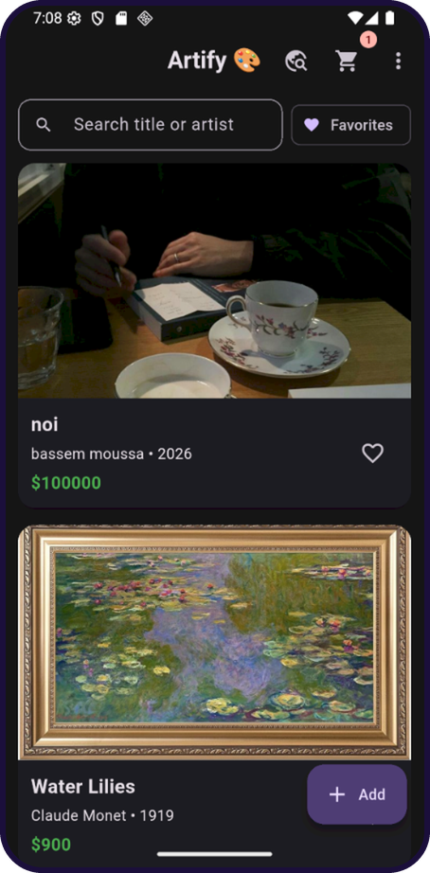
Live Demonstration
1
Register a new account, then log in (validation on wrong input)
2
Browse the gallery, search and like a painting
3
Open details and add a comment
4
Add to cart and view the total
5
Add, edit and delete a painting (CRUD)
6
Discover: search the public API and import an artwork
7
Toggle dark mode, restart the app, then show the offline error state
Artify | Mobile Development using Flutter
7
Notes:
Run the demo in this order. Demo account is ready. A backup screen recording is available in case the network or emulator fails.

Slide 8

Thank you
Sgdh Elnemr
Notes:
Thank the doctor and invite questions.

